Slide 1
Personalized Schedules for Invasive Diagnostic Tests
With Applications in Surveillance of Chronic Non-Communicable Diseases

Slide 2
A Chronic Disease
e.g., Low-grade prostate cancer

Slide 3
Immediate Treatment?
e.g., Low-grade prostate cancer
Treatment (surgery, radiotherapy)

Slide 4
(Overly) Simplified Chronic Disease Lifecycle
e.g., Low-grade prostate cancer
e.g., High-grade prostate cancer
Treatment (surgery, radiotherapy)

Slide 5
Surveillance
e.g., Low-grade prostate cancer
e.g., High-grade prostate cancer
Treatment (surgery, radiotherapy)
Cancer Progression

Slide 6
Two Types of Tests
Non-Invasive Less Accurate
Blood test, physical exam, etc.
You can do them more frequently. Often the only burden is visiting the clinic.

Slide 7
Two Types of Tests
Non Invasive Less Accurate
Blood test, physical exam, MRI etc.
You can do them more frequently. Often the only burden is visiting the clinic.
Invasive Tests
Biopsy, Colonoscopy, Endoscopy
So called Gold-standard tests.

Slide 8
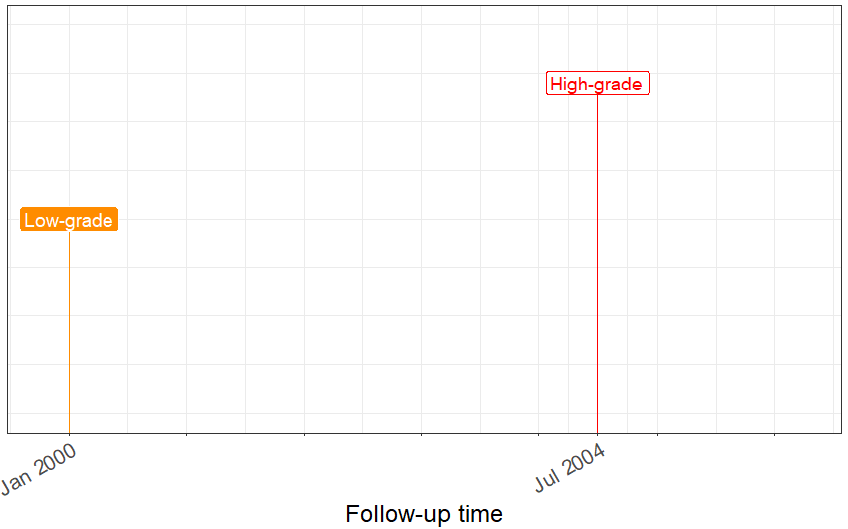
Example of Invasive Testing

Slide 9
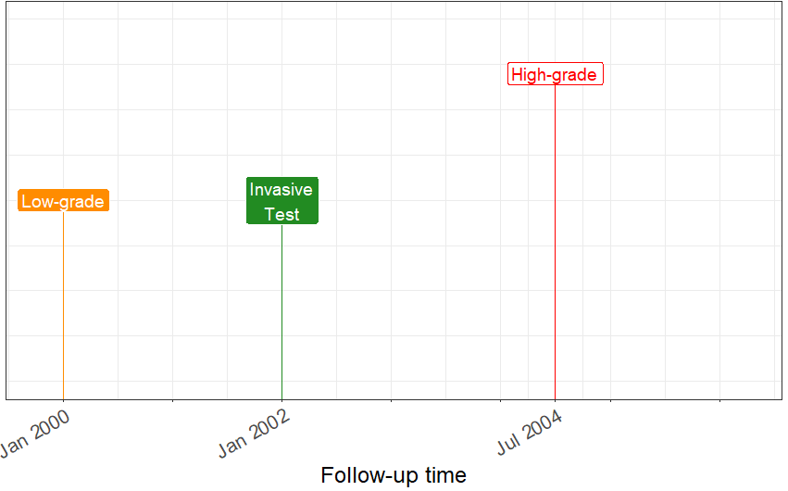
Test in 2002 shows Low-grade

Slide 10
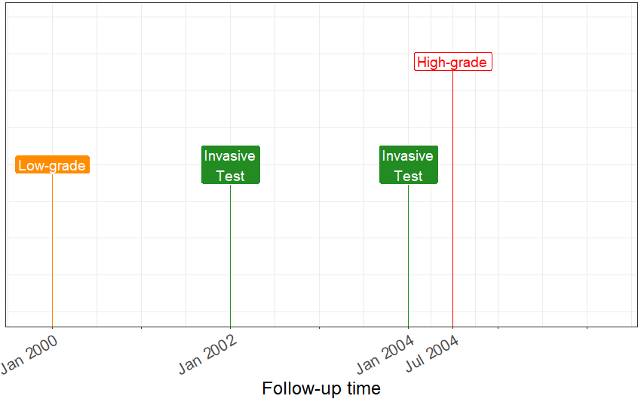
Another Test in 2004

Slide 11
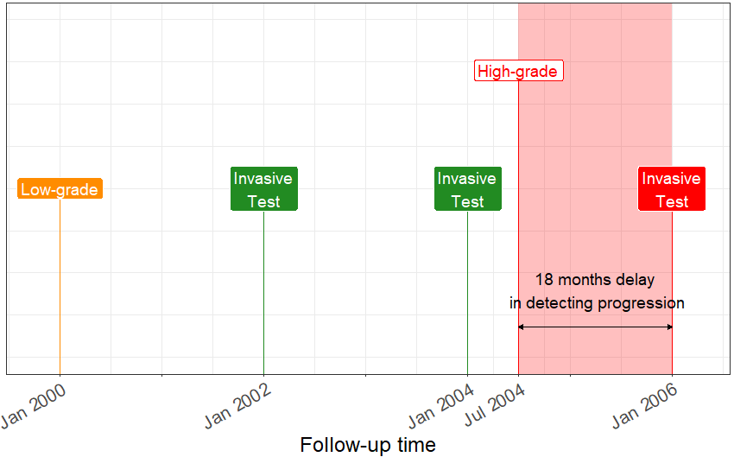
Third Test in 2006 Confirms High-grade

Slide 12
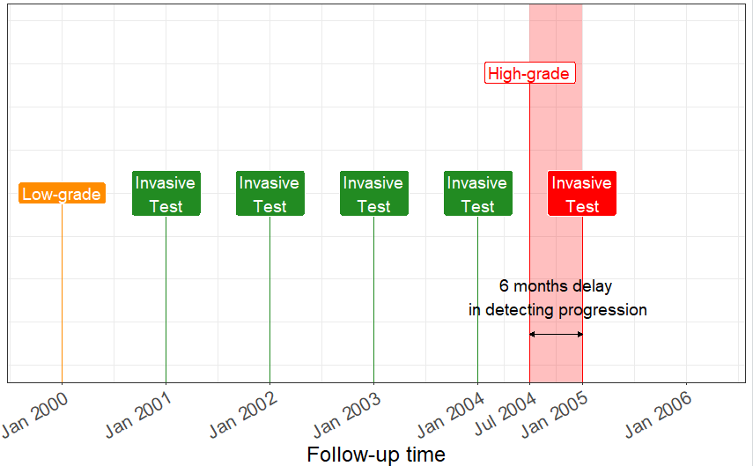
Delay vs. Number of Tests

Slide 13
However Invasive Tests Are Burdensome
Biopsy
Colonoscopy
Endoscopy
Incontinence.
Blood loss from colon perforation.
Difficulty swallowing.
Septicemia.
Chest pain.
Infection.

Slide 14
How Should We Plan Tests?
Shorter Delay
Fewer Tests

Slide 15
How Are Tests Planned Currently?
One Size Fits All
Same schedule for slow and fast progressing patients.
Flowcharts
Ignore measurement error.
Latest blood test, or latest invasive test result.
Ignores data before the latest data.

Slide 16
Biggest Concerns
Limited focus on burden (number of tests) and benefit (delay in detecting progression) of tests.
Less informative for patients.
Not complete utilization of the collected data.

Slide 17
Proposed Solution
Complete data use.
Not one-size-fits-all, but personalized to balance delay and number of tests.
Informative.

Slide 18
Complete Data Use: Joint Model Combines Data Into Disease State
Previous Test Results
Blood Test
Physical Exam
Disease State

Slide 19
Disease State Is Not Just Binary
Previous Test Results
Blood Test
Physical Exam
Low
High

Slide 20
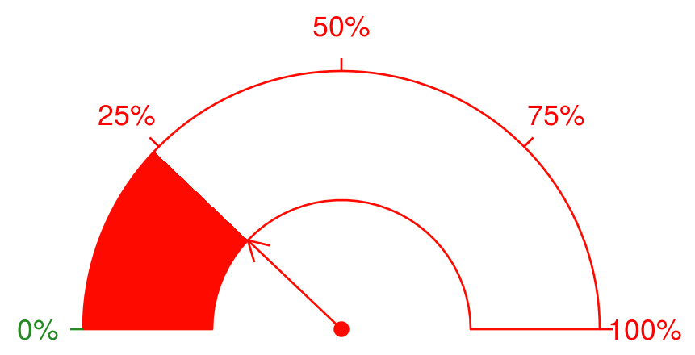
Risk of Progression: A More Precise Indicator
Previous Test Results
Blood Test
Physical Exam
Risk of Progression: 23%

Slide 21

Risk On All Future Days

Slide 22
Goal #2: Use Risk Predictions to Make Personalized Schedules.
Updates when patient data and risk of progression updates.
Learns also from data of other patients.
Chapter 2, 3, 4

Slide 23
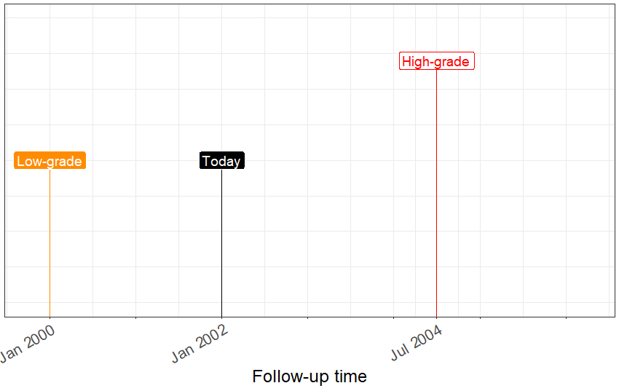
When Should We Do the Next Test?

Slide 24
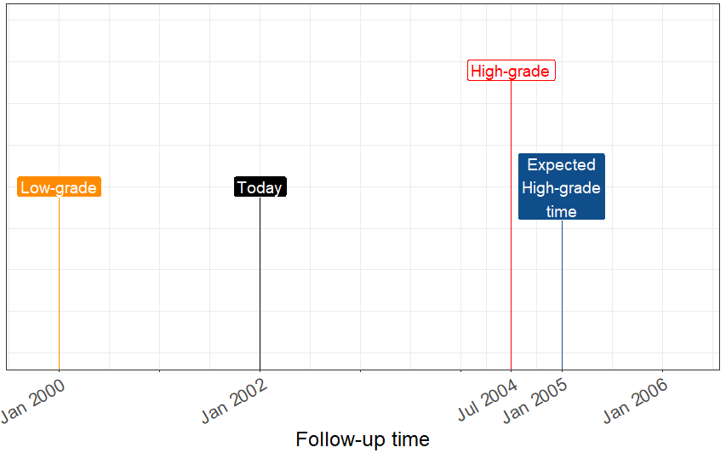
Expected Time of High-Grade Disease

Slide 25
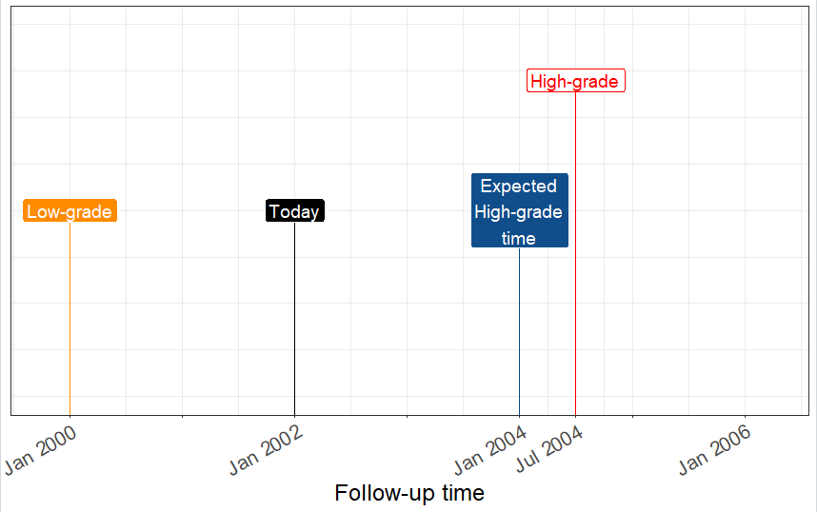
Predictions Can Go Either Way

Slide 26
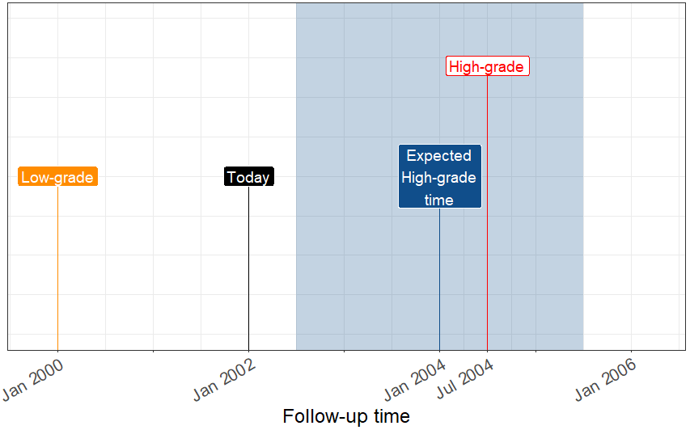
Accuracy of Predictions Can be Bad

Slide 27
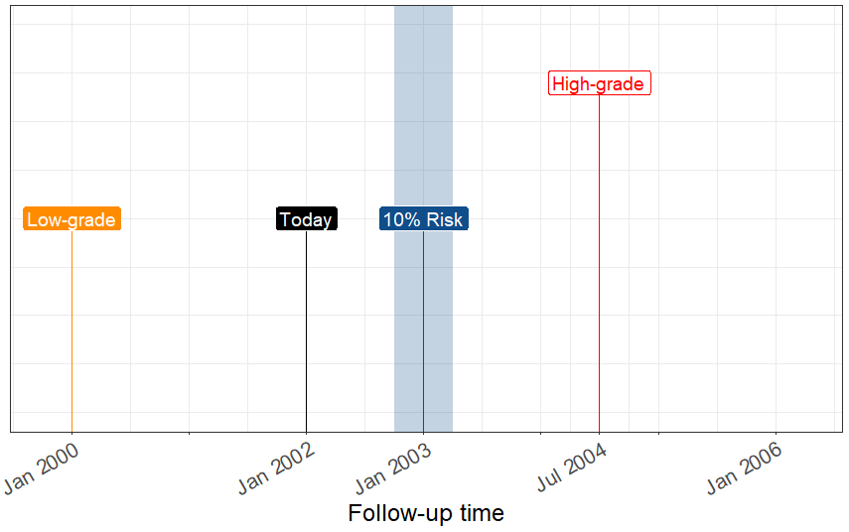
And Controlling Uncertainty Around 10% Risk

Slide 28
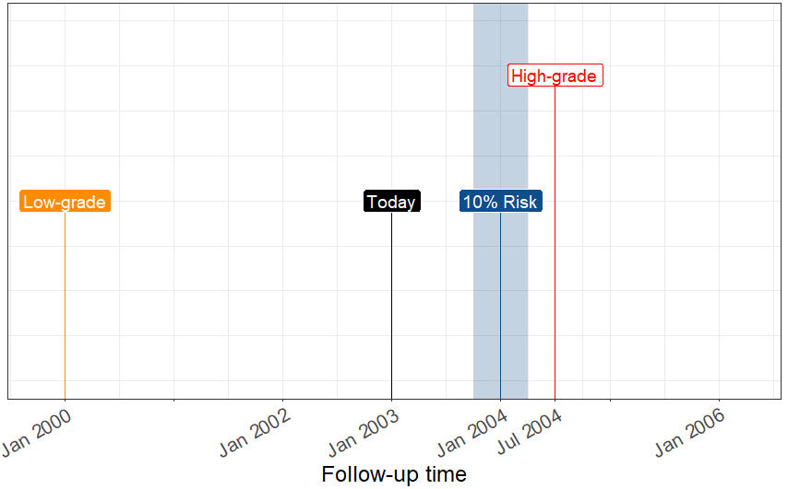
Risk Based Strategy

Slide 29
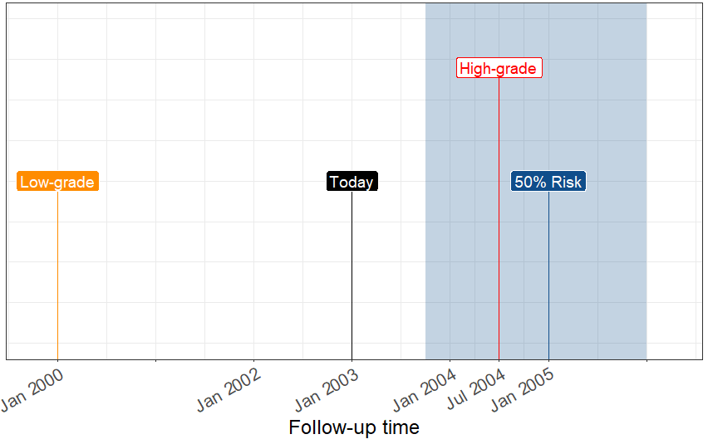
Predictions About Future Are Less Accurate

Slide 30
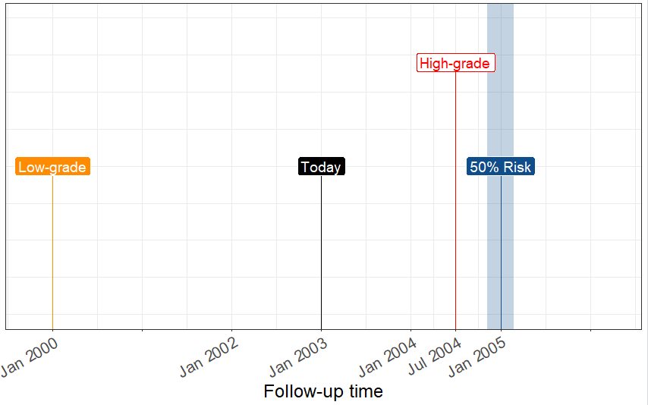
Uncertainty Matters

Slide 31
Critique
Plan one test at a time. Myopic.
Although more robust to too much delay.

Slide 32
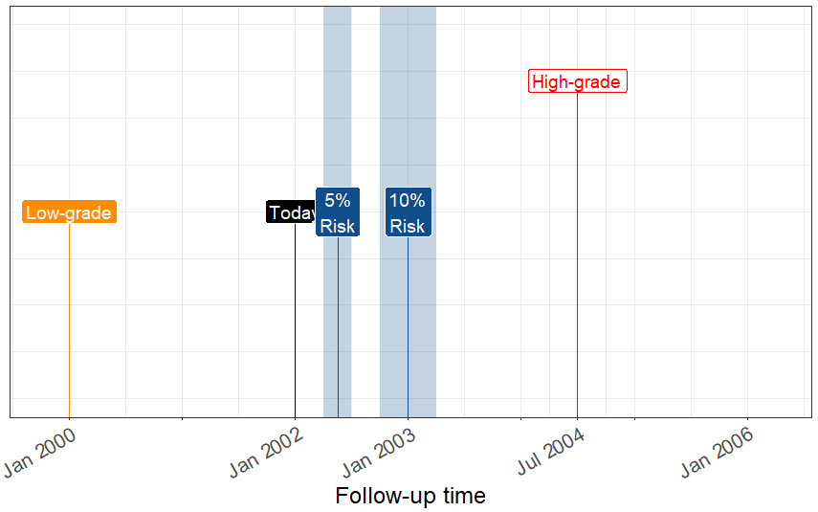
Chapter 3: Which Risk Threshold is Best?

Slide 33

Lets To a Hypothetical Trial With 125000 prostate cancer patients
………………………………

Slide 34
We Tried All Schedules on Each Patient
5% Risk Schedule
10% Risk Schedule
15% Risk Schedule
Currently used schedules for prostate cancer patients

Slide 35
We Tried All Schedules on Each Patient
5% Risk Schedule
10% Risk Schedule
15% Risk Schedule
Currently used schedules for prostate cancer patients
Number of tests
Time delay in detecting progression

Slide 36
We Tried All Schedules on Each Patient
5% Risk Schedule
10% Risk Schedule
15% Risk Schedule
Currently used schedules for prostate cancer patients
Number of tests
Time delay in detecting progression

Slide 37
Critique
Some fixed schedules are better than some risk based schedules.
Performance of personalized schedules depends on how good your data and the model is.

Slide 38
Chapter 4 for Goal #3: Create a Full Schedule of Tests and Estimate Consequences
10 years
2^10 = 1024 schedules
1024 includes fixed, personalized, or whatever method you use.

Slide 39
Goal #3: Inform Patients About Consequences of Different Schedules
Estimated Burden (total tests required)
Estimated Benefit (time delay in detecting progression)

Slide 40
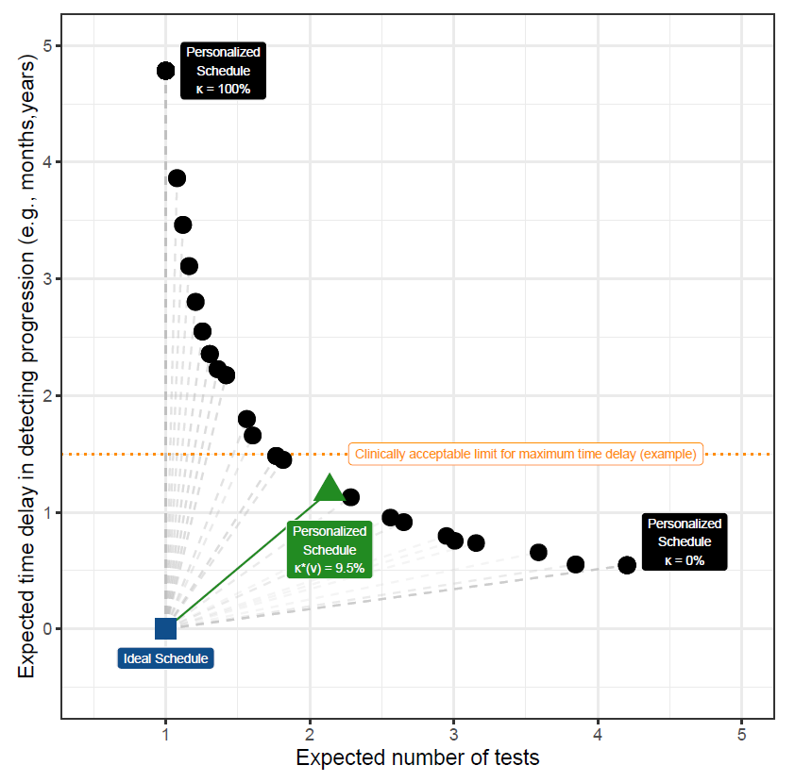
Auto Searching in Schedules

Slide 41
Applications
Prostate Cancer
Barrett’s Esophagus
Kidney Transplant
Chronic Heart Disease

Slide 42
PRIAS Prostate Cancer Surveillance
World’s largest prostate cancer surveillance dataset of low-grade prostate cancer patients.
> 7000 patients, data on PSA, biopsies.
Treatment is provided when cancer grade increases.

Slide 43
Web-Application
Model trained on the PRIAS dataset.
Externally validated on 6 of the other largest cohorts.
Schedules implemented in a web-application.

Slide 44
Conclusion: Personalized Schedules and Consequences
More Informative.
Balances delay and number of tests dynamically as per patient preferences.
Generic methodology.
Updates over follow-up.
Quality depends on data and model.

